Slide 1

City Bike Case
Nitika Puri
Xaio Wan
Zeyang Lin
Karan Prabu Kandhaswamy

Slide 2
Introduction and Background
Citi Bike is New York City’s bike share system, and the largest in the nation
Citi Bike launched in May 2013 and has become an essential part of the NY transportation network.
It's fun, efficient and affordable – not to mention healthy and good for the environment.
The bikes can be unlocked from one station and returned to any other station in the system, making them ideal for one-way trips

Slide 3
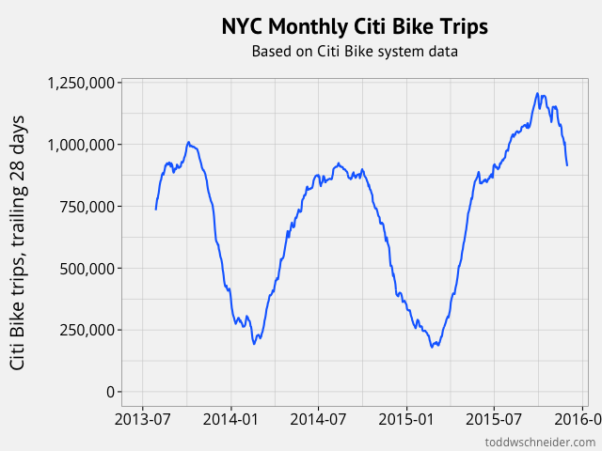
People use bike share to commute to work or school, run errands, get to appointments or social engagements, and more.
Citi Bike is available for use 24 hours/day, 7 days/week,
365 days/year, and riders have access to
thousands of bikes at hundreds of stations
across Manhattan, Brooklyn, Queens and
Jersey City.”
Such kind of massive commuter force also
generates massive amounts of data.

Slide 4
Problem Statement
After having a look at the data we observed that most of the bikes are used by people for their work. Hence the start station may not always be the same as the stop station.
This is where the problem arises.
The number of bikes that leave the station are more than the number of bikes that return back by the end of the day.
This causes less or no bikes at few popular bike stations.

Slide 5
Problem Statement
And also many times we notice that people do not find a doc to place their bike because the number of bikes returned are more than the number of bikes taken out.
We used the data from https://s3.amazonaws.com/tripdata/index.html and inferred few important things about this study one of them will be : Predicting the demand of bikes at each station on a daily basis and the availability of bikes.

Slide 6

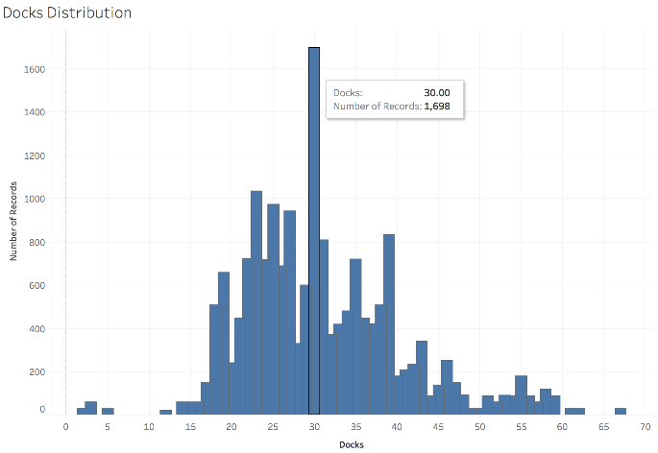
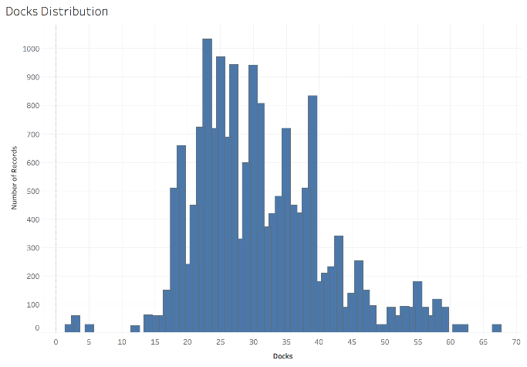
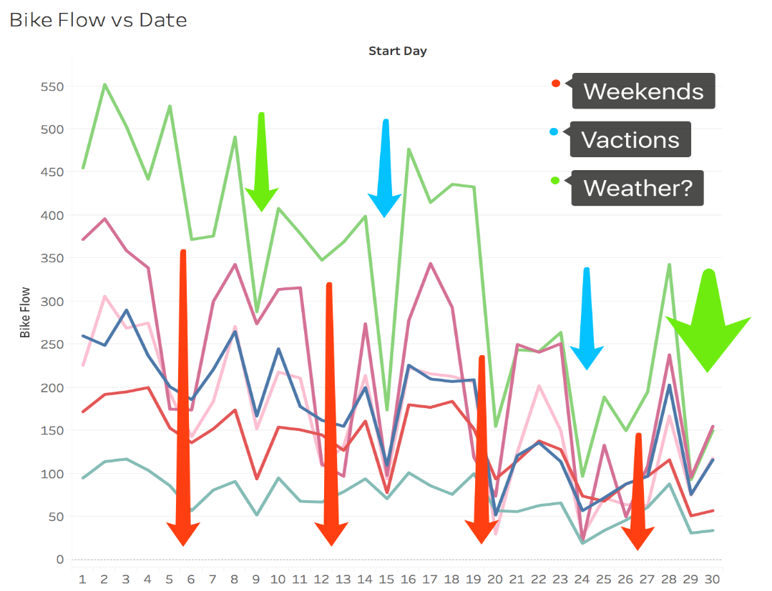
Data Exploration
Docks distribution
Fill missing value with mean: seem like middle finger…
Filter out missing value and see the distribution.
Bike flow vs Date:
Influence of bike flow of most stations:
Weekday, holiday, condition(weather)

Slide 7
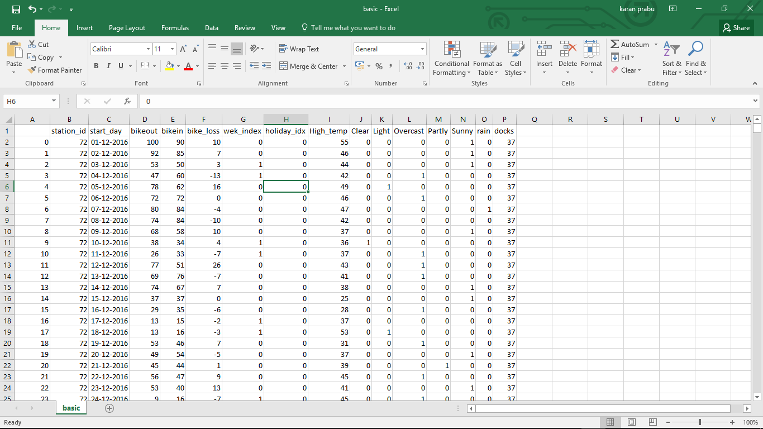
Organised & Cleaned Data
Using world weather online API we gathered data for the different days the original data used .
The data gathered are
Max temperature for the date
The average type of Climate for that day( the values that appears most frequently)
We then assigned dummy variables (flags of (0’s and 1’s) for the type of climate for each day and represented the climate type as columns

Slide 8
Dependent Variable
The variables which we used for regression (Dependent Variable) are chosen on the basis
Y-Axis = “bike_loss” which is found but getting the difference between the out bikes and in bikes for each station on a particular day (positive values denote the bikes lost and negative values denote the bike gained on that day)

Slide 9
Independent Variables
X-Axis = comprises of columns below:
wek_index= which ranges from 0-1 where 0 denotes Weekday and 1 denotes Weekend.
holiday_idx = which ranges from 0-1 where 1 denotes holidays and 0 denotes its not.
High_temp = this column has values of highest temperature in F, on that day.
Clear, Light, Overcast, Partly, Sunny and rain = These columns has range 0-1 where 1 denotes that climate for that day and 0 denotes its not.

Slide 10
Regression: Overview
Grid Search(Inside Each Model)
Models Comparison(Between Models)
Prediction Using the Best Model
Visualization Using the Best Model

Slide 11
Grid Search
1. Description: Grid search is an approach to parameter tuning that will methodically build and evaluate a model for each combination of algorithm parameters specified in a grid.
2. Models For Grid Search:
Lasso Regression(α)
Random Forest(Number of Estimates; Max Features)
Neural Network(Hidden Layer Size; Activation Type; Max Iteration)
3. Grid Search Result(Next Slide)

Slide 12
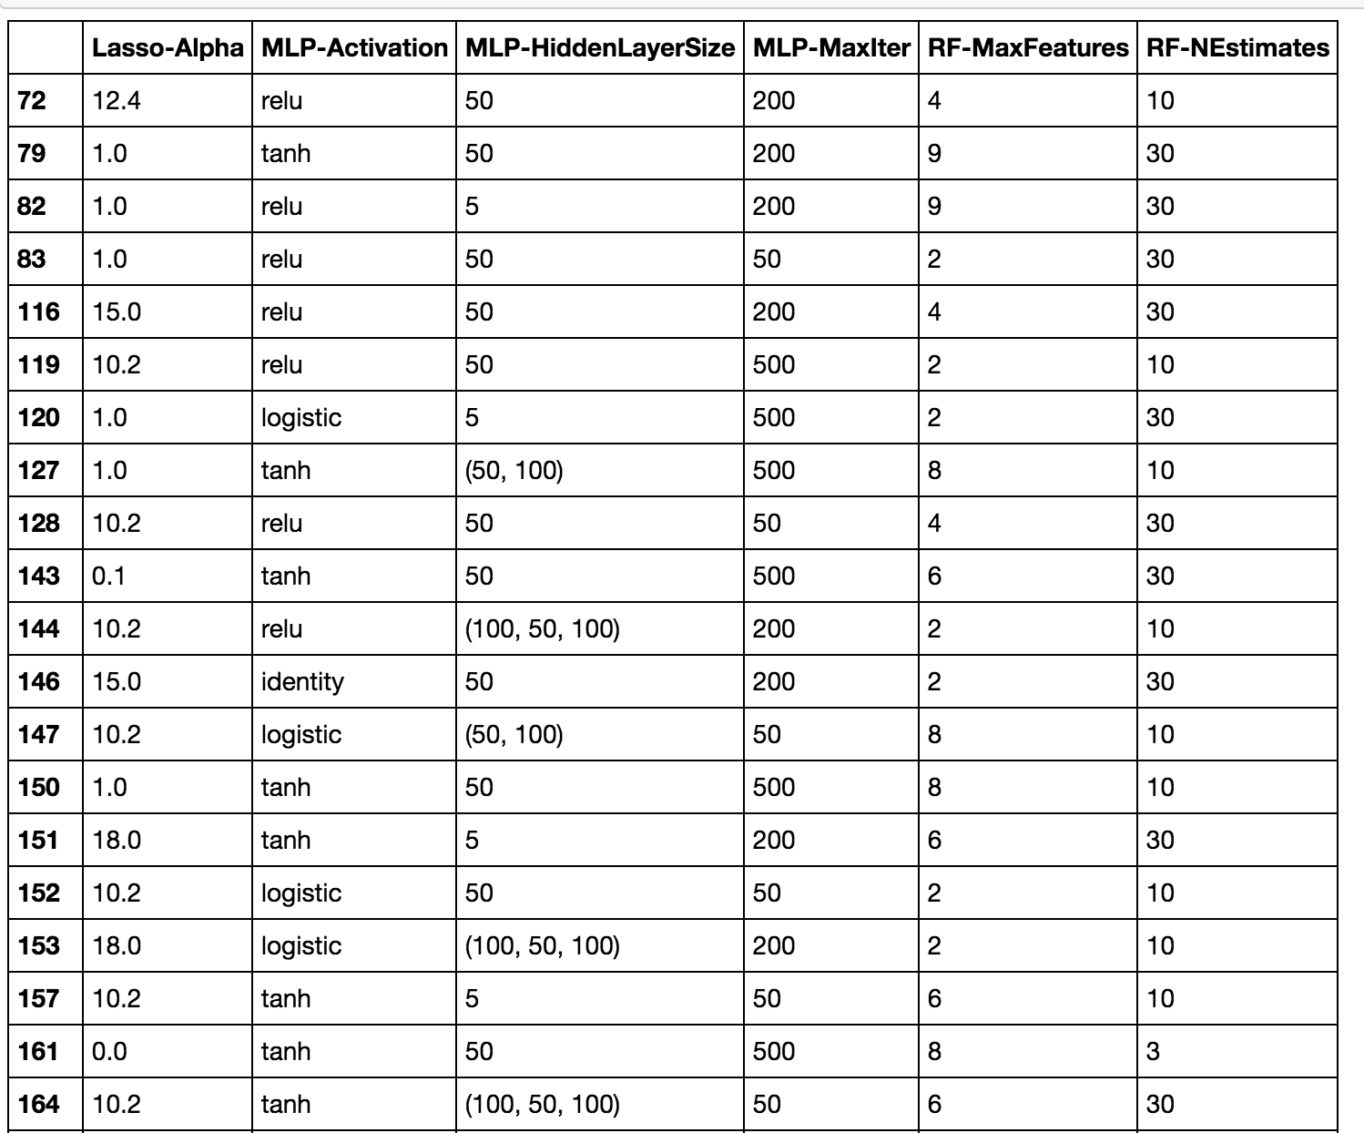
Grid Search Result(Partial)
Each Model:
Parameter Used for Every Station

Slide 13
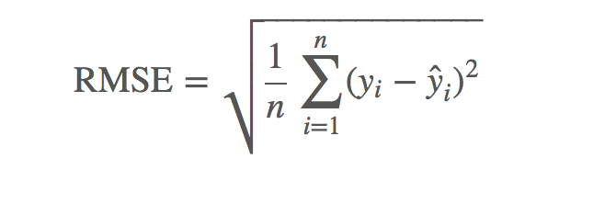
Models Comparison
Types of Models Used: Linear Regression; Lasso Regression; Random Forest; Neural Network.
Progress: For Each Model, implement Cross Validation for each station(Sample Size=3 Months), use average RMSE(Root Mean Squared Error) to be the accuracy of that model.

Slide 14
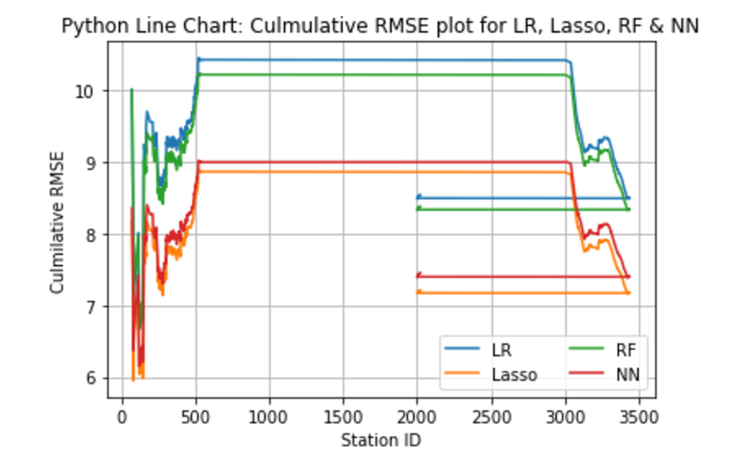
Models Comparison: Result
Cumulative RMSE Comparison:
Lasso Regression seems to be the best model.
But all coefficient in lasso regression are 0.
So we chose Neural Network.

Slide 15
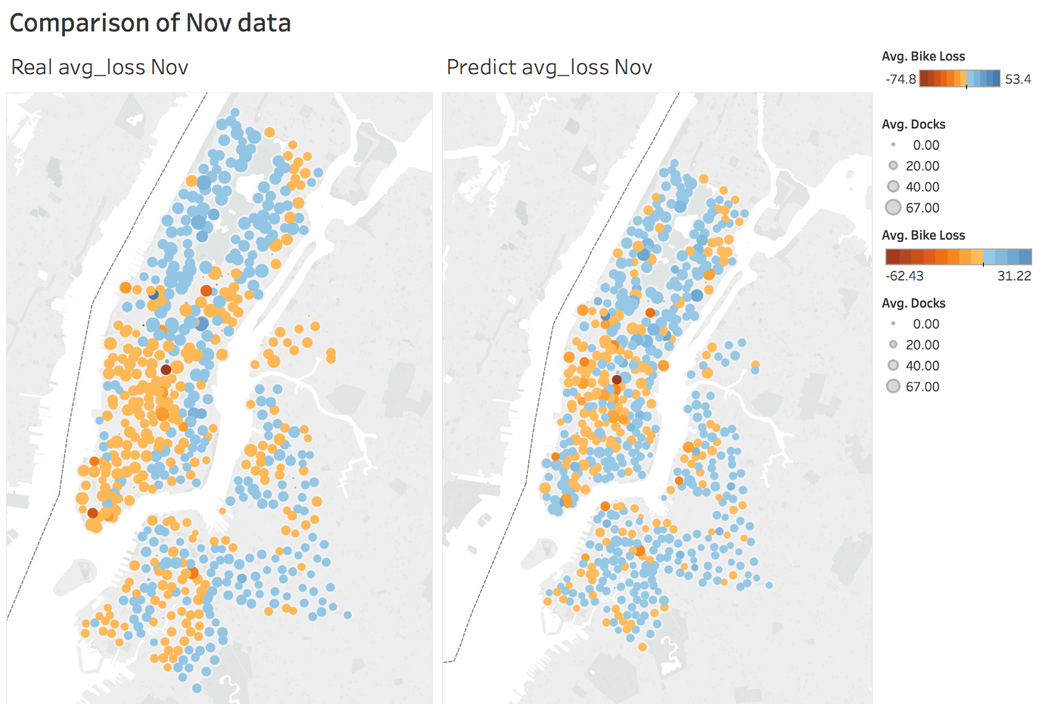
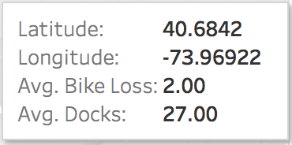
Visualization: Neural Network
Testing data: 2016.11
True & Prediction Comparison :
Spot: station
Color: daily loss of bike
Size: # dock

Slide 16
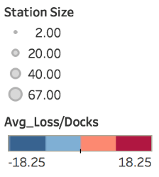
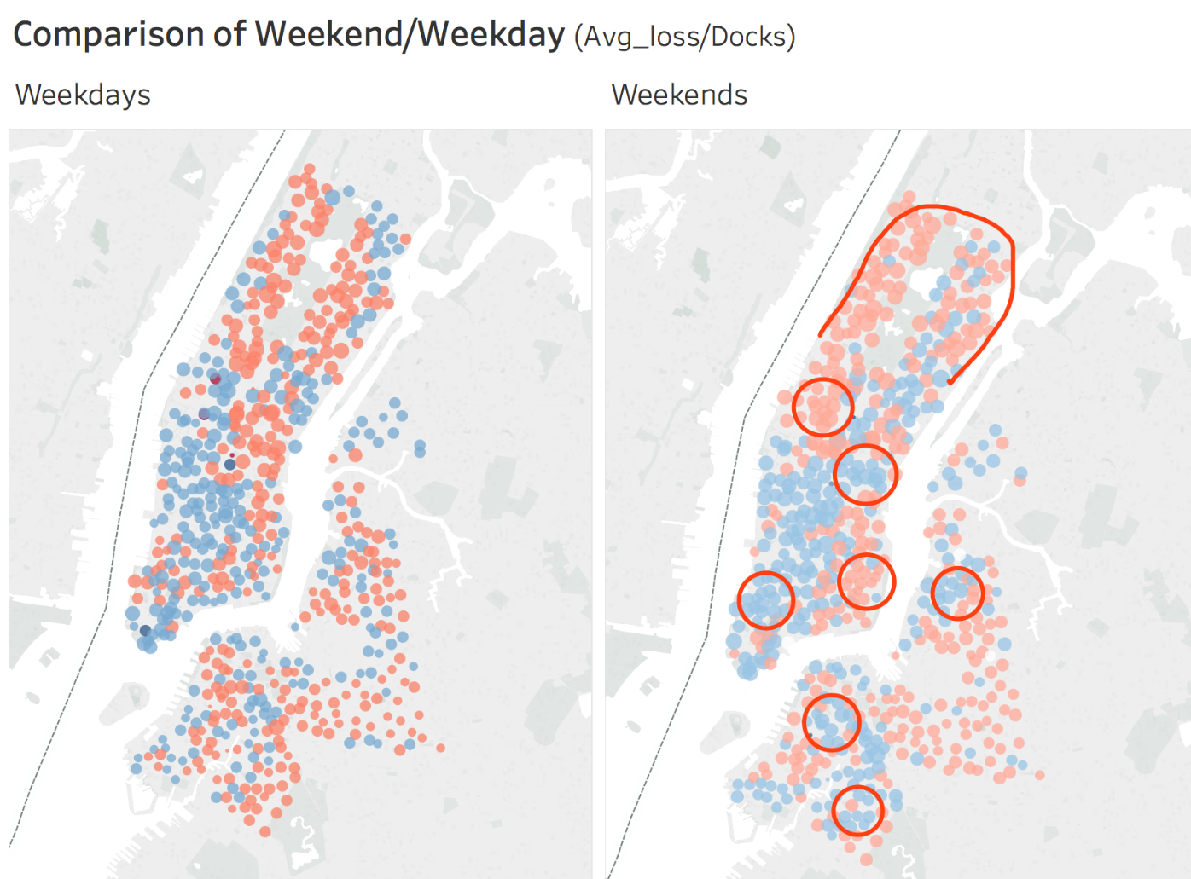
Result Analysis: Weekday/Weekend
Result data: 2016.11
Weekday & Weekend Comparison :
Spot: station
Color: loss/docks
Size: # dock
Difference:
Number of bike loss
Bike oscillation in areas

Slide 17
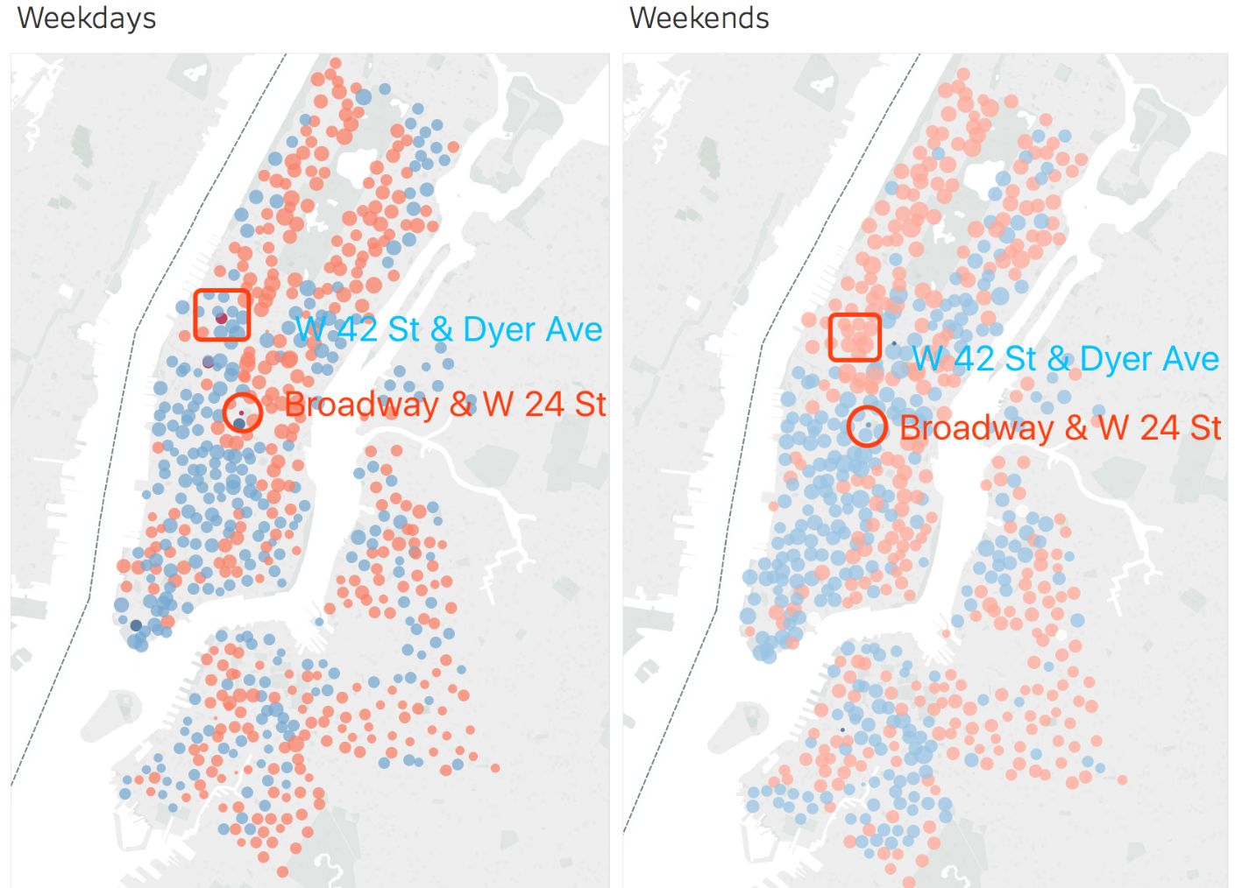
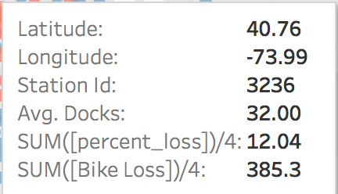
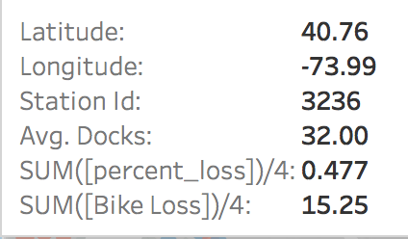
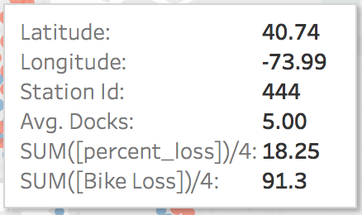
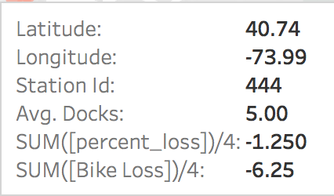
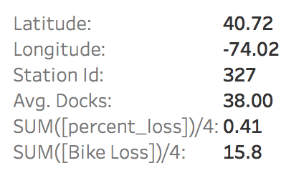
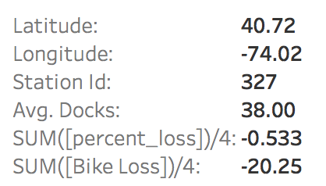
Result Analysis: Sample Stations
Station 327:
Bikes out on weekdays
Bikes in on weekends
Station 444:
Small station with large bike flows
Take a breath on weekends
Station 3236:
Persistent losing of bikes

Slide 18
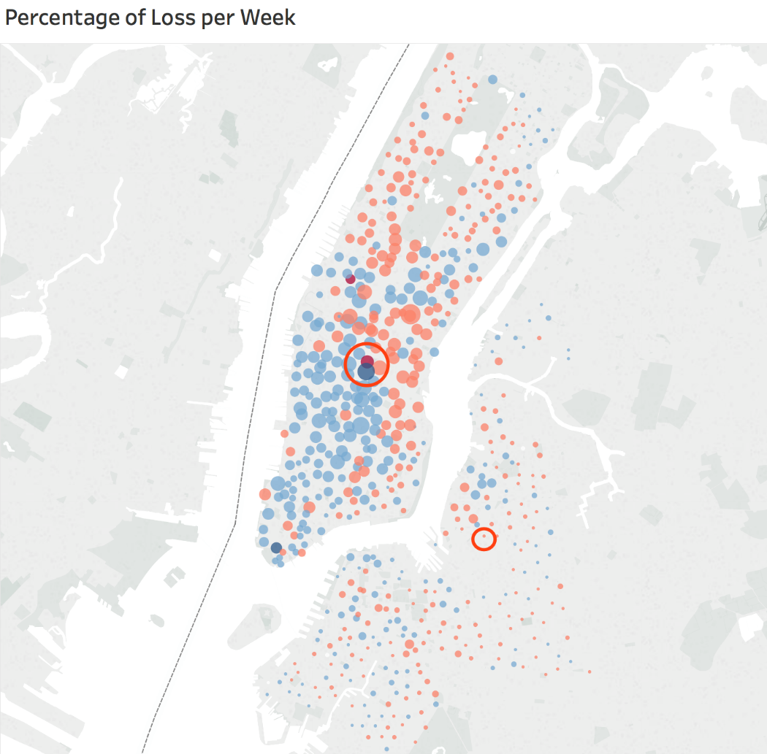
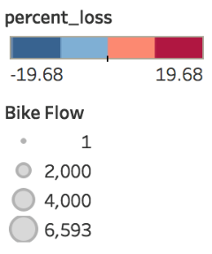
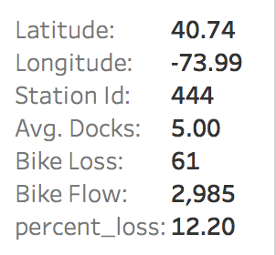
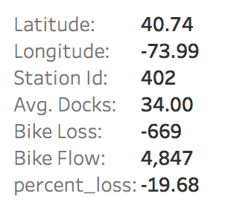
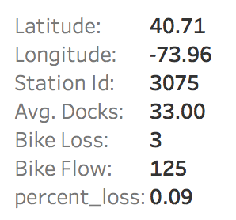
Result Analysis: Loss per Week
Weekly Loss:
Color: weekly loss/docks
Size: # bike flow
Notice:
Self-balance per week
Busy stations get priority
Small stations can be busy

Slide 19
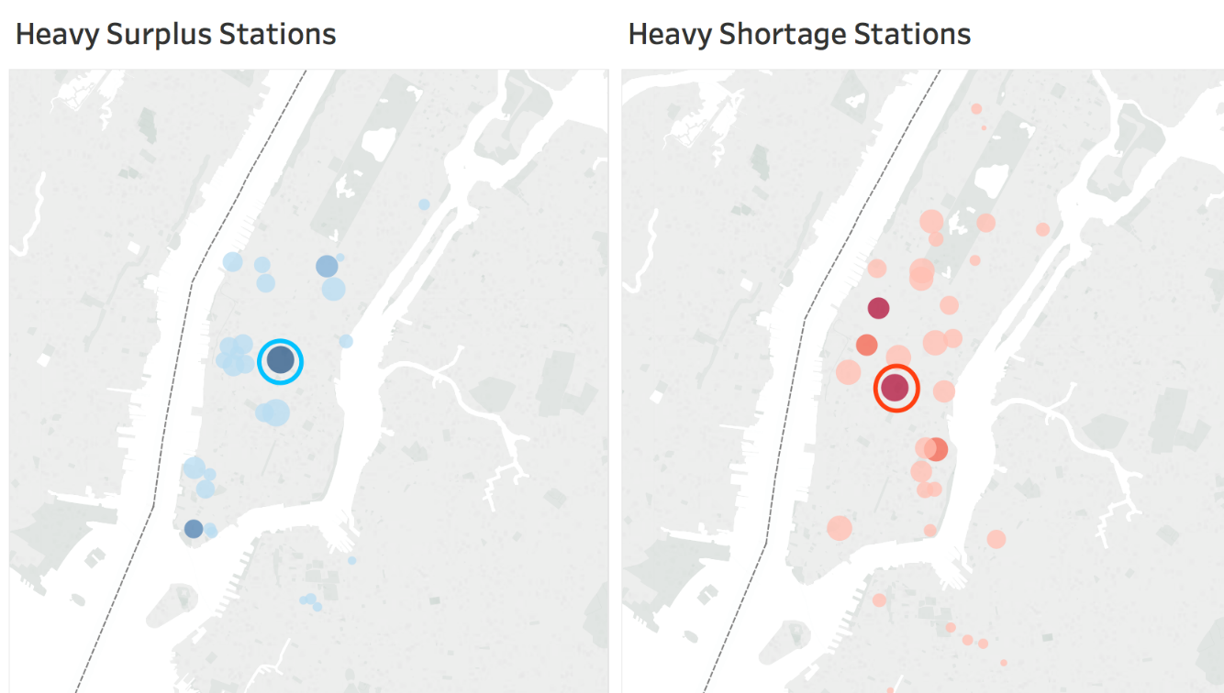
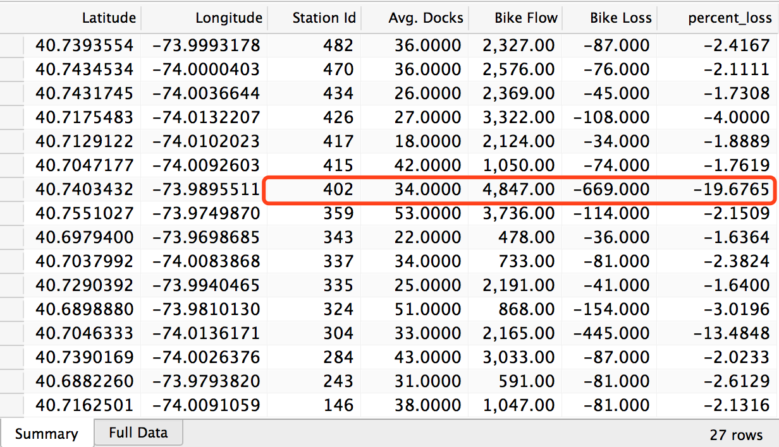
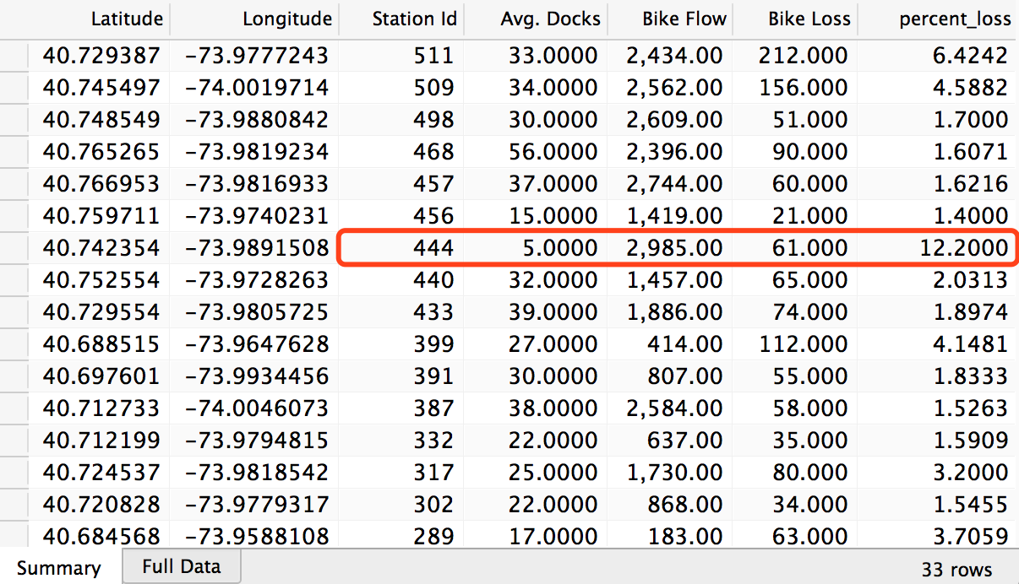
Result Analysis: Urgent Rebalance
Heavy loss of busy station:
Color: sum(loss in a week)/docks
Size: # bike flow
Notice:
Need daily supplementation
Busy stations get priority
Station 402
Station 444

Slide 20
Conclusion & Next Step
Early warning of bike exhaustion
Optimization of system rebalance plan
Minimize total distance of bike transport
Given weekday/weather/seasonal status
Suggestion of extension of stations

